Slide 1




Empowering Data Scientists with Reusable Solutions
Data scientists face tight deadlines and stakeholder expectations.
Reusable solutions boost productivity by standardizing approaches.
They reduce development time.
Reduce code peer-reviews.
Minimize errors.
SA
by Sotiris Adamakis

Slide 2
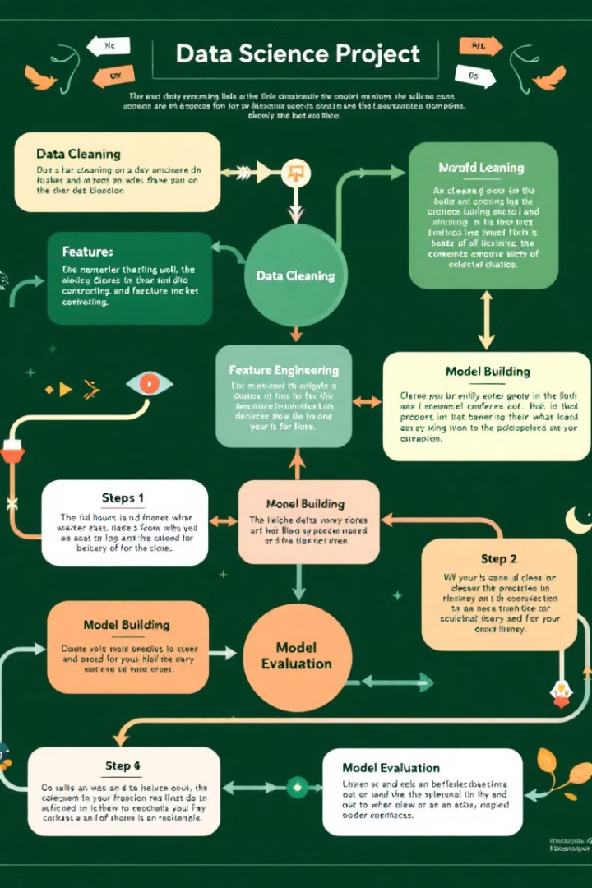




Supervised Modeling Solution: Key Steps
Feature Engineering
Variable Reduction
Refine feature set for optimal modeling by impute missing values, replacing outliers, one hot encoding.
Reduce dimensionality and complexity and focus on impactful features by removing features with high missing value percentage, low IV, highly correlated.
Model Development
Reporting
Develop a robust logistic regression model by using Lasso and p-values for model selection.
Assess data quality. Model performance and evaluation metrics.
This Photo by Unknown Author is licensed under CC BY

Slide 3

Dealing with multiple datasets
If the user has multiple datasets, such as training and validation datasets, the solution expects a single table where all datasets are stacked together.
Sample weight, amount variable and Sample variable are optional.
Required variables
Optional variables
Training
Predictive features
Target variable
Sample weight
Amount variable
Sample
Training
In-time validation
In-time validation
Out-of-time validation
Out-of-time validation

